Slide 1
Authentication Based Attacks

Slide 2
Objectives
Discuss what authentication is and how it’s performed
Understand what points in the authentication process are vulnerable to attack
Discuss how users habits can introduce risk in the way they authenticate

Slide 3
Authentication
RFC 4949 defines user authentication as “The process of verifying an identity claimed by or for a system entity”
This could be a user or system
We also call this a “security principal”
It’s really an object
Can the object authenticate?

Slide 4
Authentication Steps
Identification Step
Presents an identifier to the system
Could be a security principal
Verification Step
Is there something that validates or verifies the identity presented or security principal presented

Slide 5
Authentication Systems
There are many authentication systems in existence
Think about how many devices you own
Think about how many times you log into something
Windows
Credential providers, Windows 10
Linux
PAM
CAS, SSO, AUTH, ETC

Slide 6
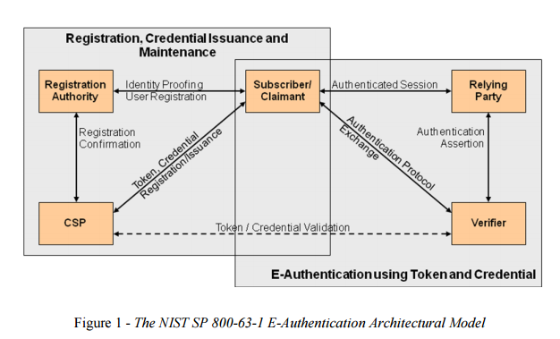
E-Authentication Architectural Model

Slide 7
Factors of Identification
Something you know
Password
PIN
Security Questions
Something you have
Smartcard
Physical Token
Something you are
Fingerprint
Iris
Something you do
Voice pattern
Handwriting

Slide 8
Threats to something you know
Password authentication
Phishing
Poor password management techniques
Key logging
Other eavesdropping
Password based attacks
Password cracking
Rainbow tables
Password storage attacks
Secret questions
Easy to obtain answers

Slide 9
Threats to something you have
Very few
Usually protected with a chip
However, RFID copying
Magnetic copying

Slide 10
Threats to something you are
Some say the industry just isn’t there yet
Many “facial recognition” systems are fooled with a print out of your face
False positives or false negatives are issues with this

Slide 11
Overall security issues
Eavesdropping
Replay
Malware
Denial of Service
Host and client based attacks
Really depends on the how clever you are

